Slide 1
Impact of Executive Pay on Firm’s Performance
- Analysis by Keval Chheda.

Slide 2
Introduction
Over the past decade, executive compensation is seen to be aligned to firm’s performance.
In this project, we are trying to analyze various aspects of executive pay data to identify its affect on the company’s performance.

Slide 3
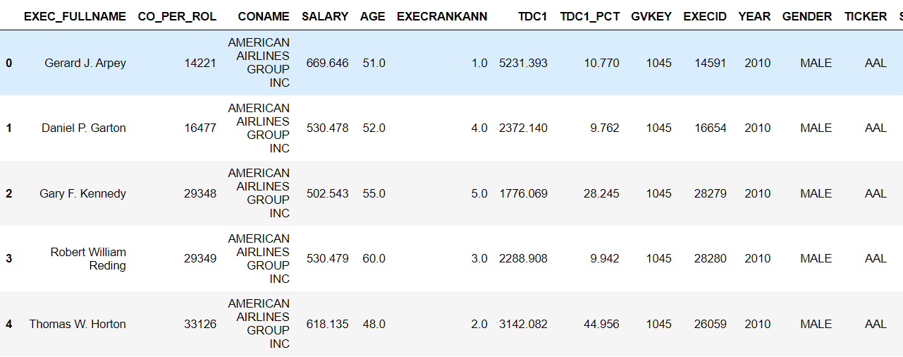
Task 1 - Data Modelling
In this task we will try to explain executive salary with the given variables.
In the provided data, we have 27,292 rows and 13 columns.
The below image represents first five entries and all the columns of the data frame.

Slide 4
Identifying relevant columns to build a model.
Upon exploring the data, it was found that only 3 columns can be the candidates to build the model.
1. Executive Rank (EXECRANKANN)
2. Total Compensation (TDC1)
3. Salary (SALARY)
Out of these three variables, Salary is our target variable whereas Executive Rank and Total Compensation are our independent variables

Slide 5
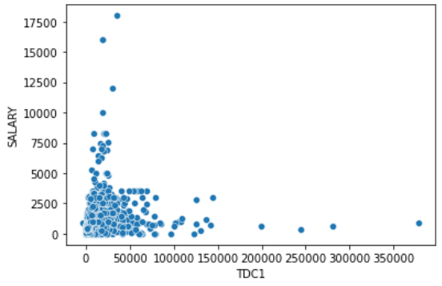
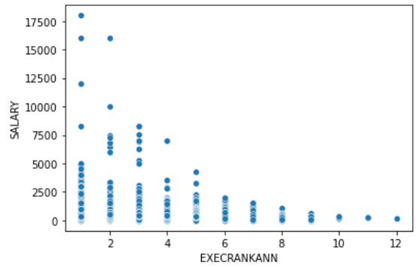
Visual Analysis
To identify the trend between the independent variables and the target variable, we have plotted the data points.
Salary vs TDC1 - It is evident from the scatter plot that there is no relation between Salary and Total Compensation (TDC1) of the Executive.
Salary vs Executive rank – We can observe a decreasing trend in Salary with increasing rank of the Executives

Slide 6
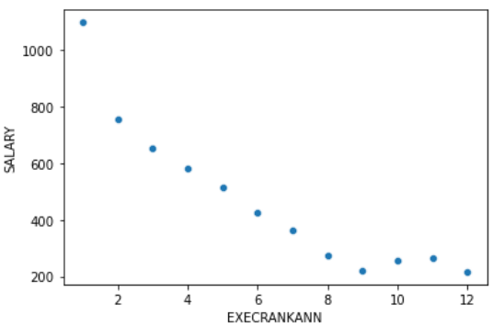
Visual Analysis
As the range of the data points corresponding to each executive rank is large, we will take the average of salary based on the executive rank.
By plotting the scatter plot of average Salary w.r.t Executive Rank, we can clearly observe a negative linear relation between Salary and Executive Rank.

Slide 7
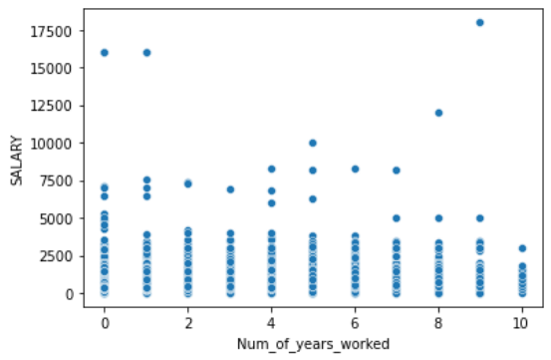
Creating new columns using the given data
As we have only one independent variable, we try to find other possible factors which can possibly affect the Salary of the executive.
One of which might be Number of Years an executive worked in a particular firm.
Upon plotting Number of Years worked with Salary, we can conclude that there is no significant relation between the two variables.

Slide 8
Building the Model
We will use Ordinary Least Squares regression to describe the relationship between the independent variable (Executive Rank) and dependent variable (Salary).
Assumptions-
Executive's Gender has no relationship with Executive's Salary.

Slide 9
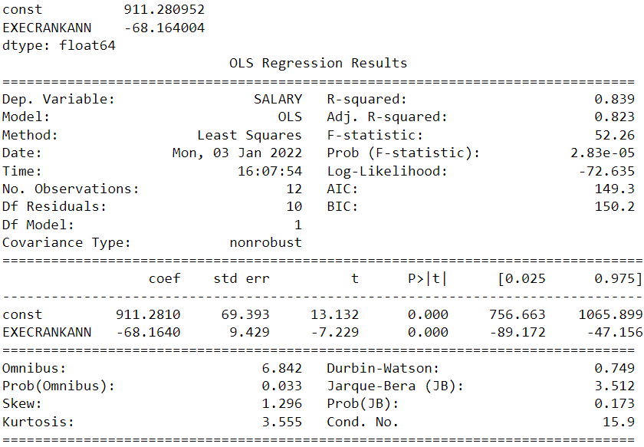
Results

Slide 10
Task 2 – Machine Learning
We have used Yahoo Finance website to pair each row in the data with the company’s corresponding high stock price during the specified year.
To build the model, we would consider Total compensation (TDC1) column.

Slide 11
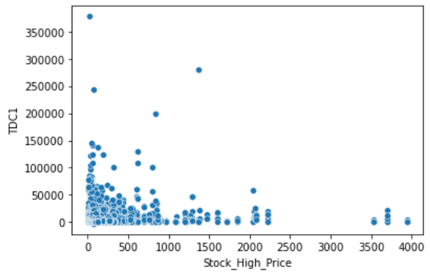
Visual Analysis
After pairing each row of the data frame with corresponding high stock price, we plotted the TDC1 vs Stock High Price to identify the relation between the two variables.
By analyzing the scatter plot, we are unable to obtain any trend.
As the range of the data points is vast, we would normalize the data and then try to find the relationship.

Slide 12
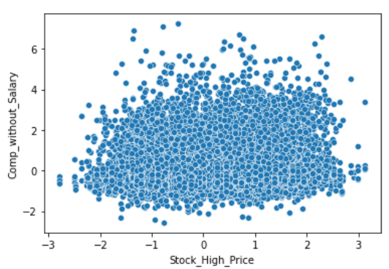
Visual Analysis
The result of the scatter plot after normalization is not satisfactory.
We have obtained a cluster showing no trend which can predict stock price

Slide 13
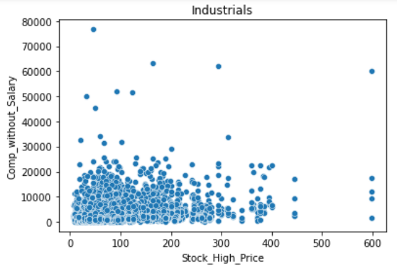
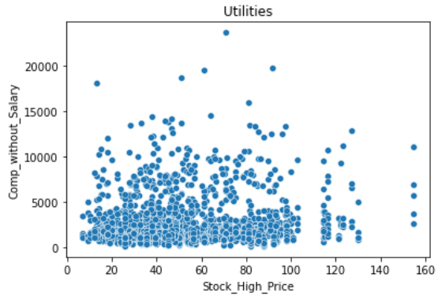
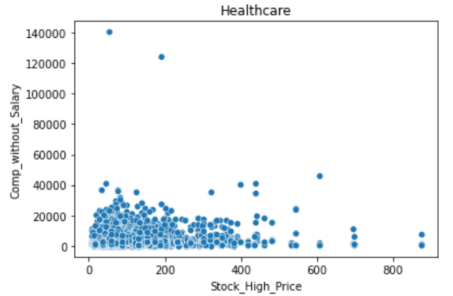
Classifying Companies w.r.t Industries
As the compensation percentage of executives vary from industry to industry, we have classified companies w.r.t Industries.
After classification we have plotted Compensation without salary vs Stock price for every industry.

Slide 14
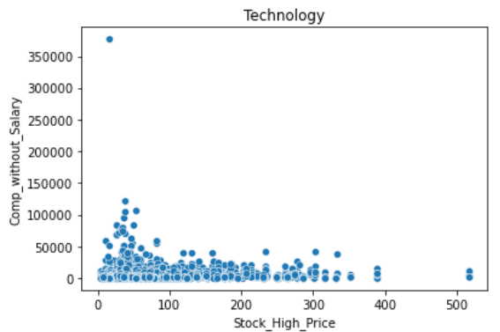
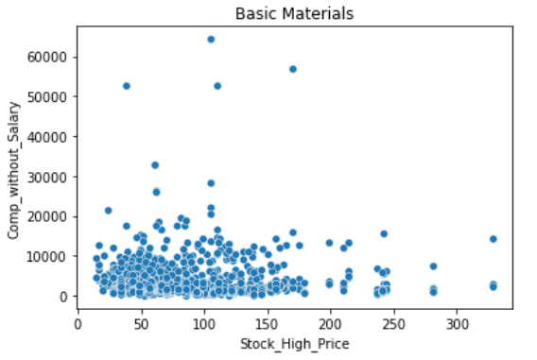
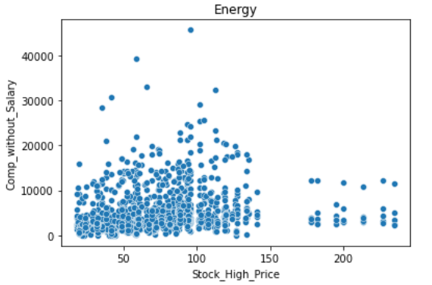
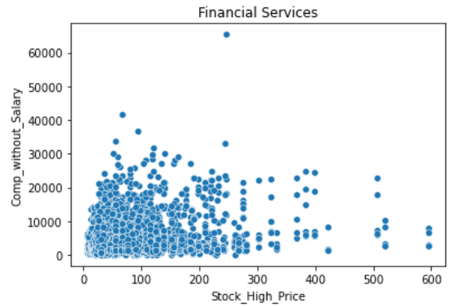
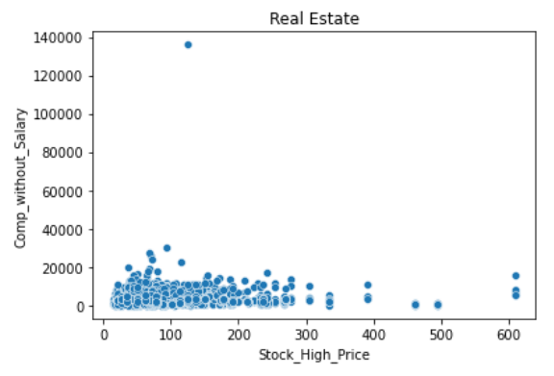
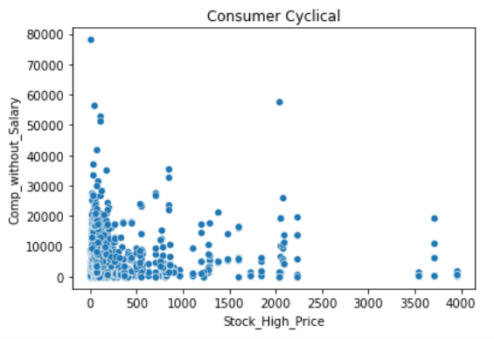
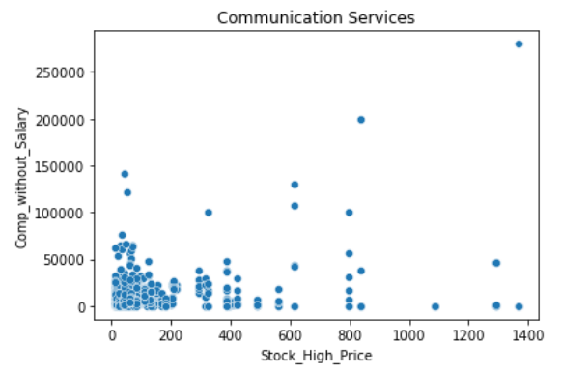
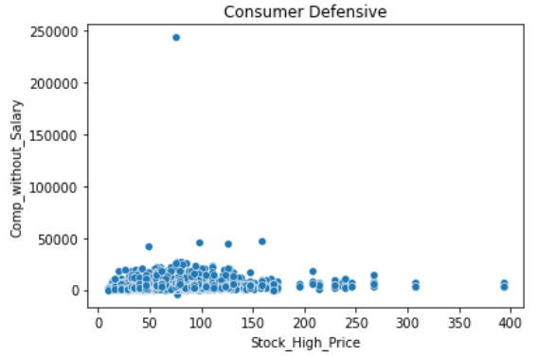

Slide 15
Building the Model
As there is no trend to be seen in the scatterplots, we would use non – linear machine learning model i.e K Nearest Neighbors.
KNN can fit regression as well as classification problems.
We have used only one independent variable, that is Normalized Total Compensation to build the model. Our target variable is Stock Price.
On building the model, we got maximum score of 0.6 for n_neighbors = 1.

Slide 16
Conclusion
The Total Compensation (TDC1) value is majorly influenced by Salary + Bonus. This makes it difficult to get other form of incentives which might be dependent on stock price.
Factors such as overconfidence, personal benefits and many more can influence the stock price and the total compensation of the employees.
Hence, the Total Compensation (TDC1) of executive alone cannot predict the stock price of a firm.

Slide 17
Thank You

